Slide 1
Building the Next Generation LMS From the Inside Out
Dr. Charles Severance
University of Michigan School of Information
Longsight, Inc.
ESUP Meeting – Paris – 06-Feb-2015

Slide 2
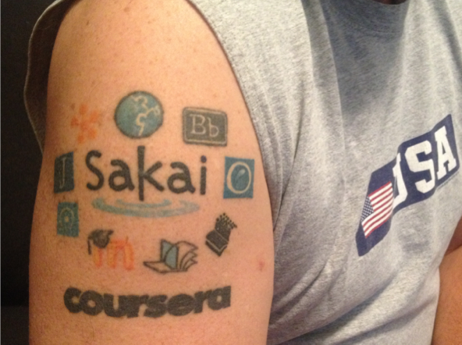


Slide 3
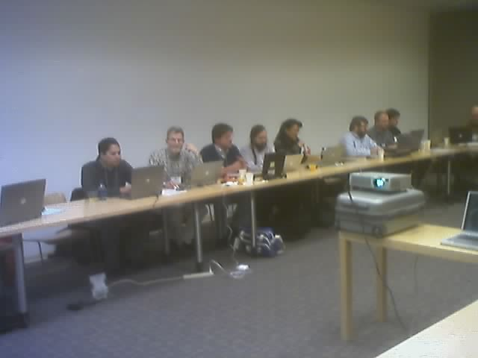
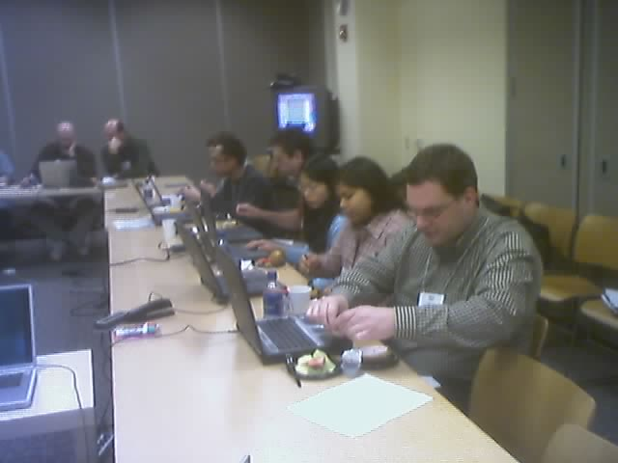
February 19, 2004 - Sakai All Hands Meeting @ Stanford

Slide 4
At 02:28 PM 3/2/2004 -0500, Chris Etesse wrote:
Chuck, Jeff and Babi,
It was my pleasure talking to you both during my travels recently - Chuck in person in Edinburgh and Jeff & Babi via phone from Europe. As promised, I wanted to pass on a link to a white paper we just released on Blackboard & Standards as well as restate my invitation to host a meeting at Blackboard with Chuck to discuss how we can interoperate going forward. Finally, the second link is to the Blackboard SDK's for our various products - I thought it might be of some interest. I look forward to working closer with you each.
Warmest regards,
Christopher Etesse
Senior Director of Technology
Blackboard Inc.

Slide 5
DRAFT Software Portability Workgroup Prospectus DRAFT
The current trend in web-based systems for eLearning has been moving steadily towards increasing componentization and modularity. This trend is driven to a large extent by the desire for systems deployers to easily enhance system functionality to more quickly and effectively support the maturing demands of LMS users. Three notable examples are referenced here:
Blackboard Building Blocks
Sakai’s Tool Portability Profile
WebCT PowerLinks SDK
Joseph Hardin
University of Michigan
September 3, 2004

Slide 6
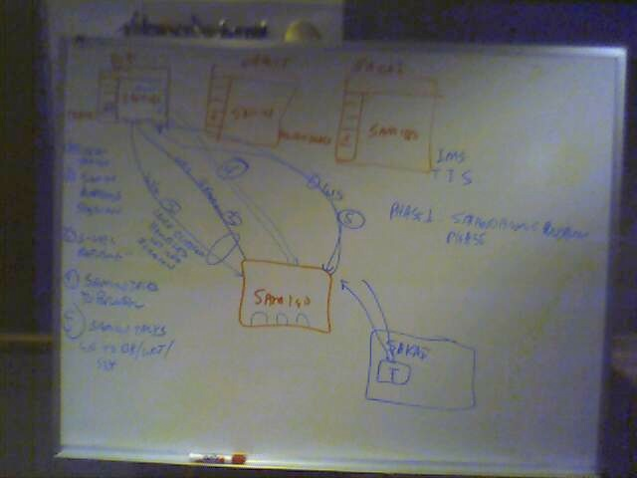
Brainstorming at IMS Meeting in Denver 2004-10-19

Slide 7
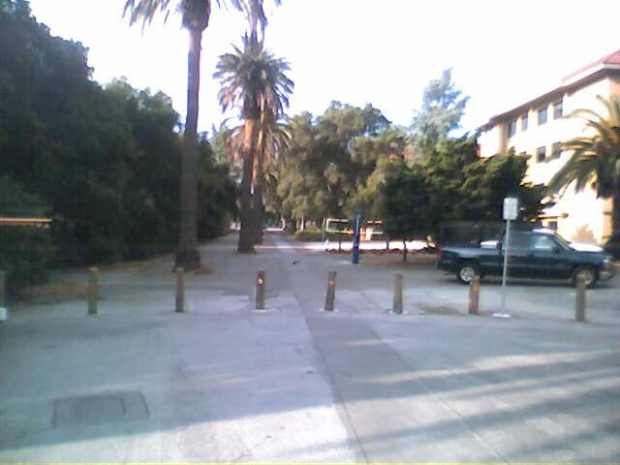
Publisher Meeting @ Stanford
Colleagues:
It looks like we have about 25 individuals (give or take) attending the SCP/SCA/Board meeting on 4/27/2005 from 1-5 pm. This includes the Board (9). See list below. At this point, I'd rather not invite any more people.
Textbook Publishers Invited/Attending...............................................
Allen Noren, O'Reilly & Associates -- ATTENDING
Ray Henderson, Pearson Education -- ATTENDING
Schoen, Steve, Thomson Higher Education -- ATTENDING
David Serbun, Houghton Mifflin Company -- ATTENDING
Jonathan Stowe, John Wiley & Sons, Inc. -- ATTENDING
Glenn Kammen, Intelecom -- ATTENDING
Vivian 'Vivie' Sinou
Dean, Distance & Mediated Learning
Foothill College

Slide 8
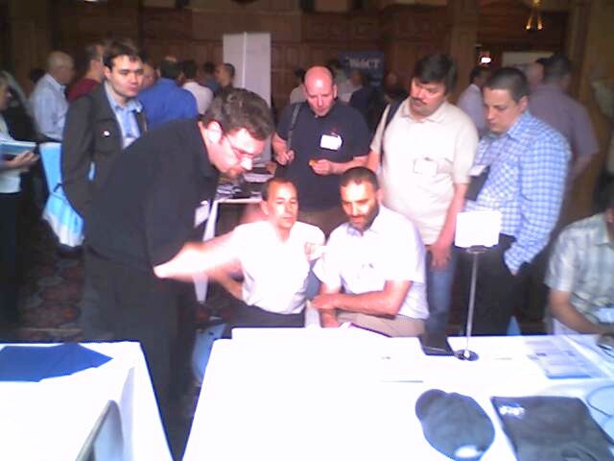
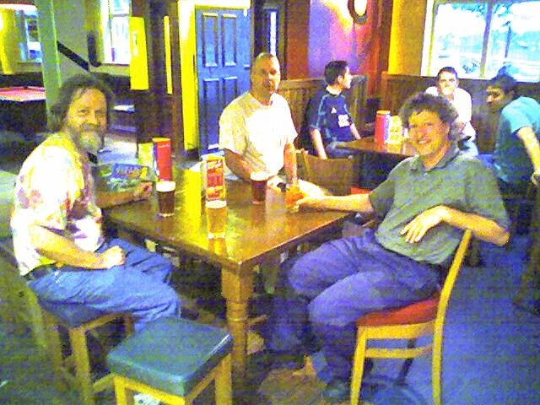
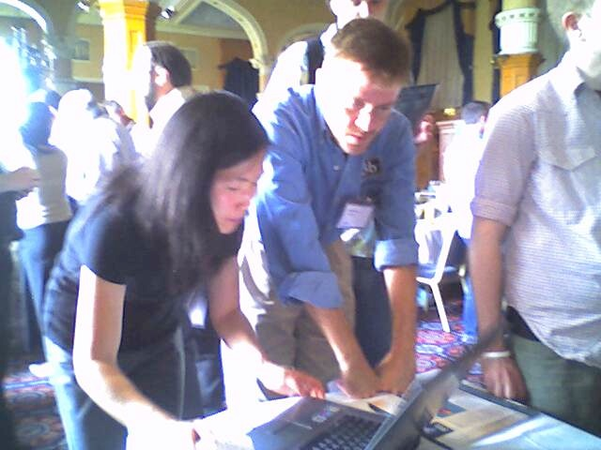
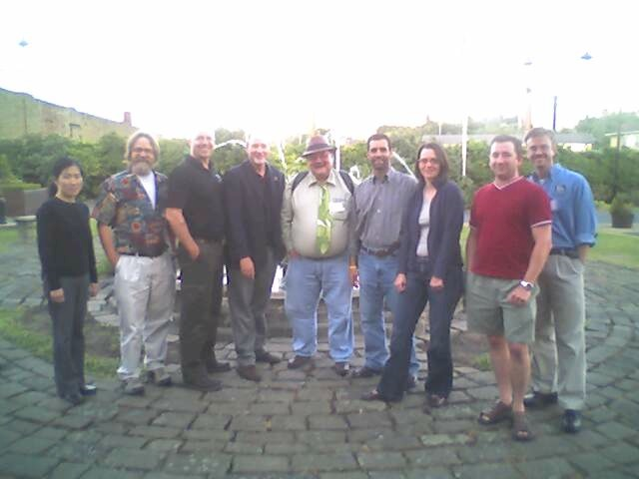
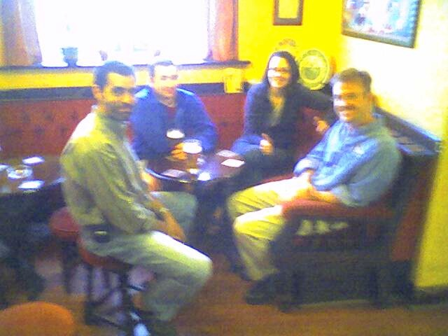
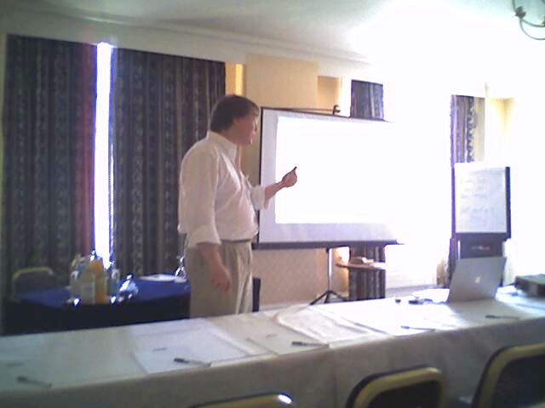
June 21, 2005,
IMS Alt-I-Lab Sheffield, UK

Slide 9
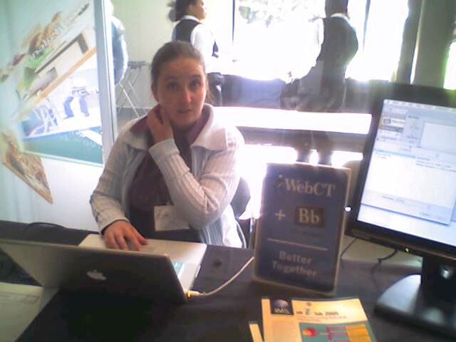
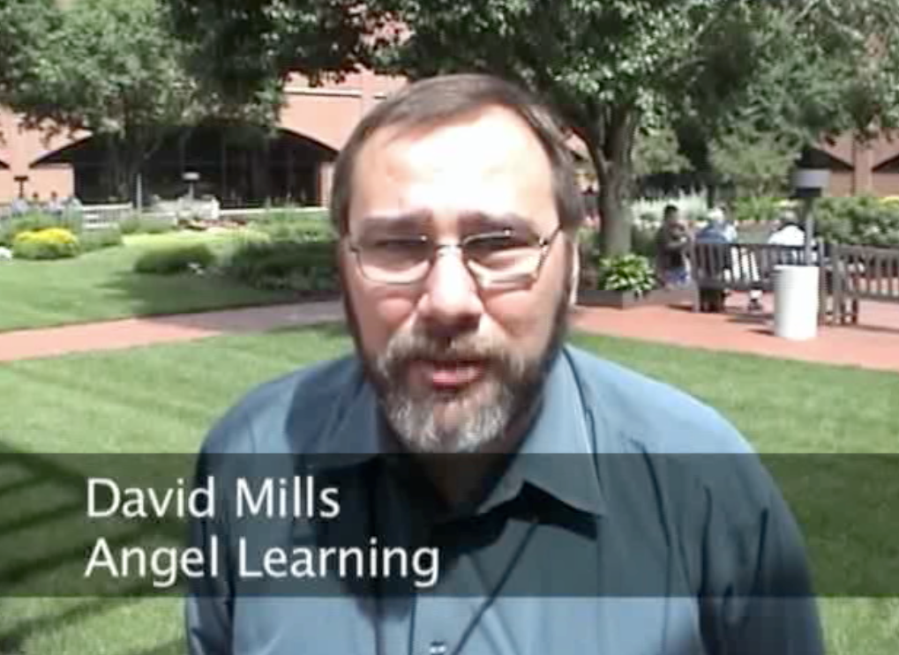
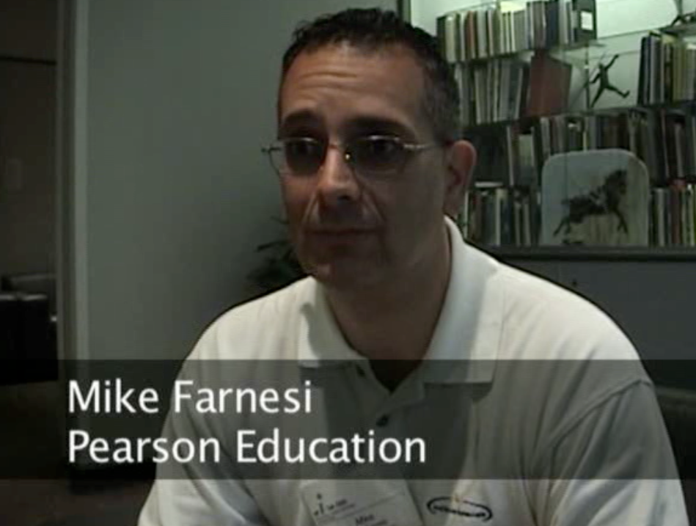
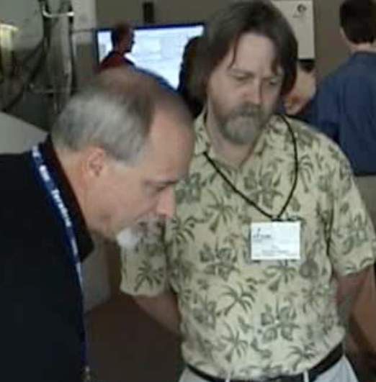
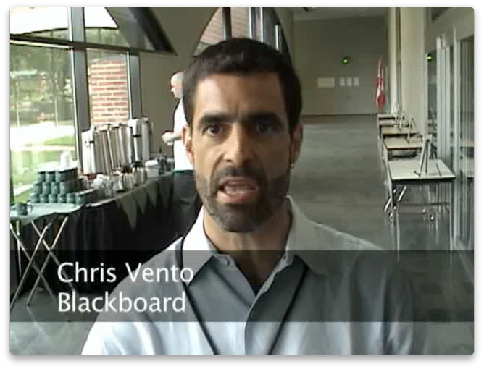
June 21, 2006
IMS Alt-I-Lab
Indianapolis, IN

Slide 10
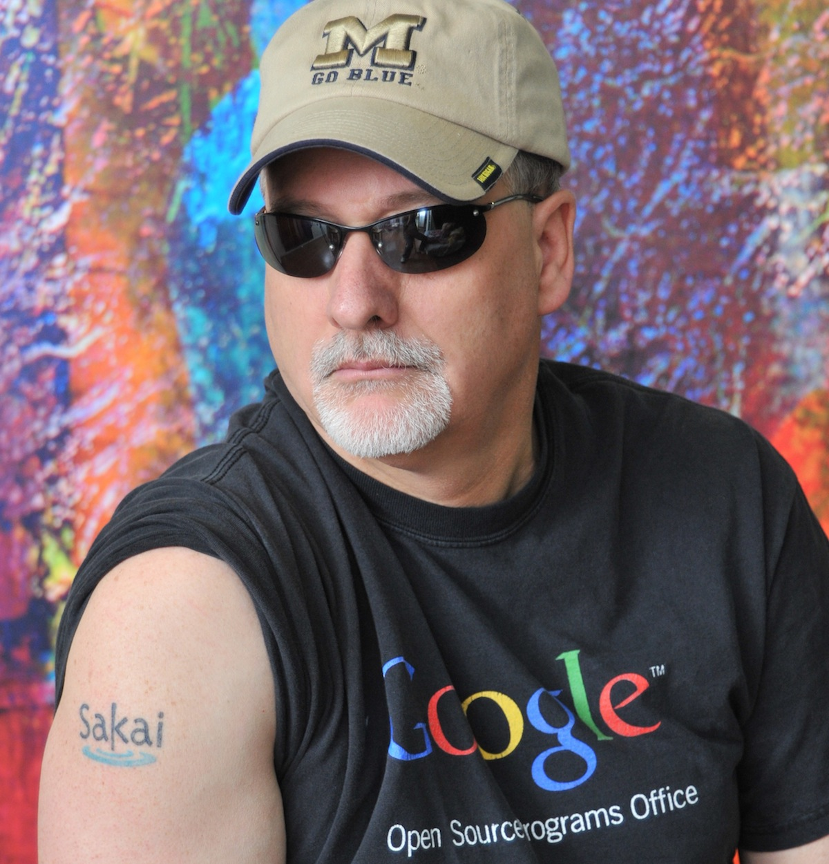

February 2007

Slide 11
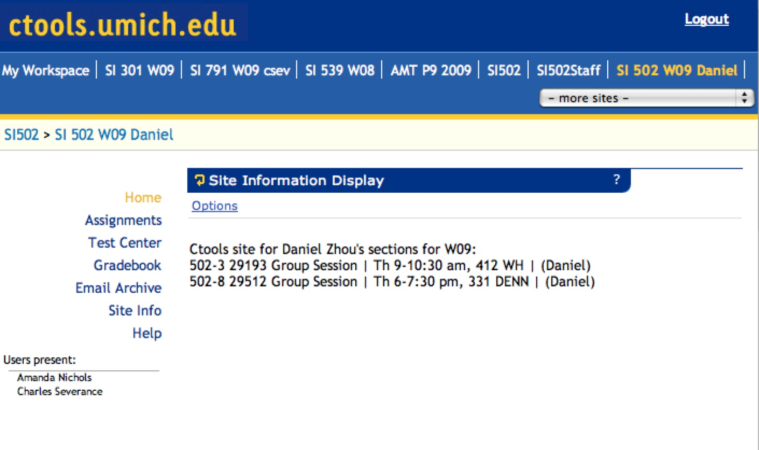
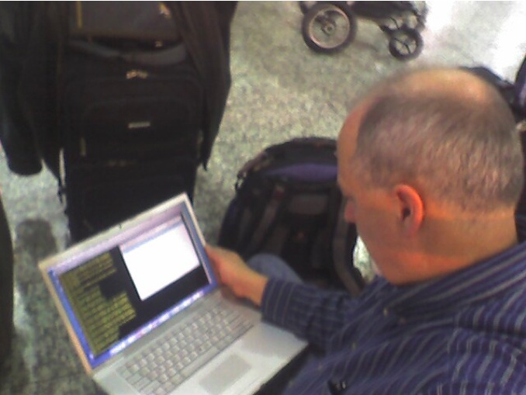

2007

Slide 12
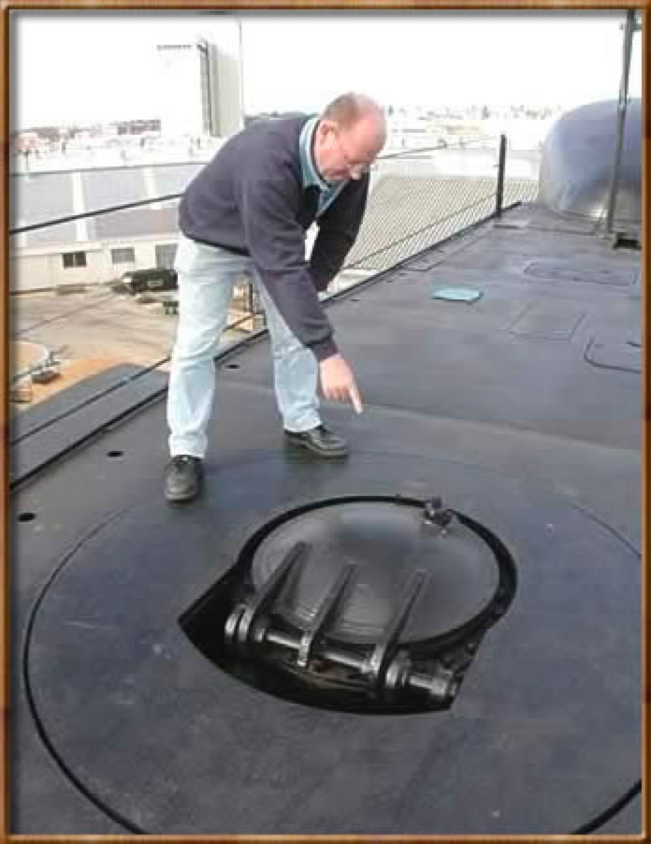
Escape from the LMS!!

Slide 13
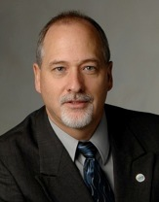

Tools
Interoperability
Commercial
Common
Cartridge
Publishers
LMS
Open Source
Standards
2008
www.imsglobal.org

Slide 14

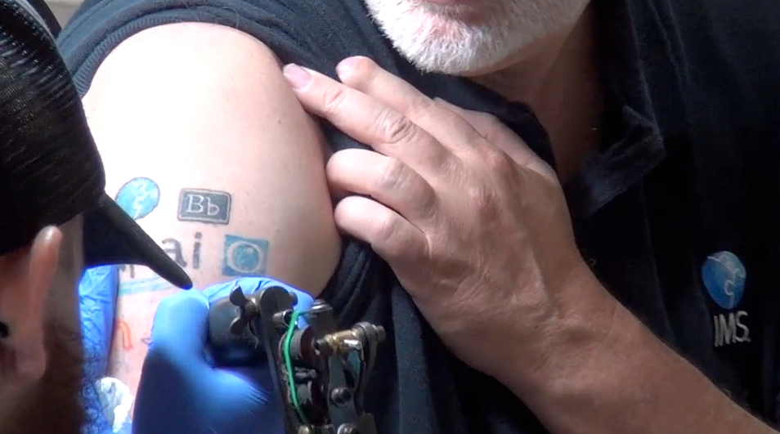
July 2012
http://www.youtube.com/watch?v=VY-Ogkc7Mnw

Slide 15












Success has a million parents...

Slide 16
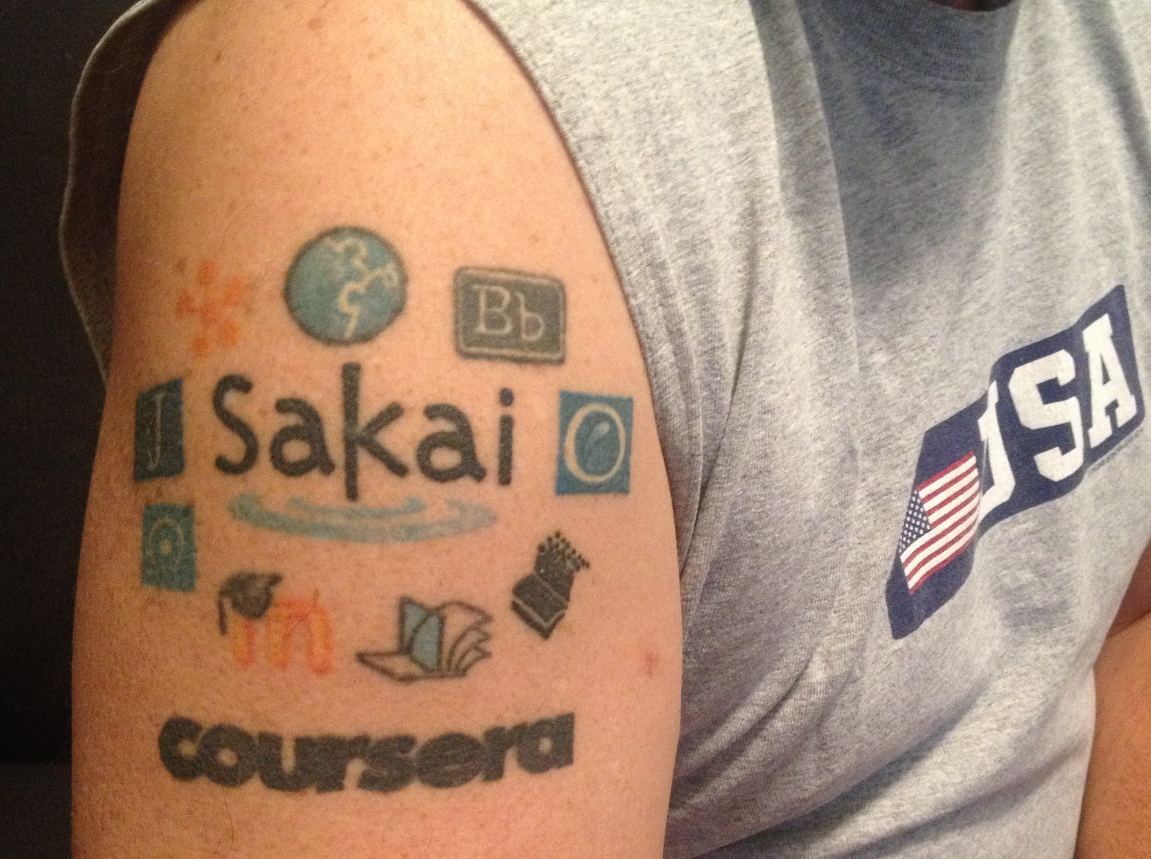

Slide 17
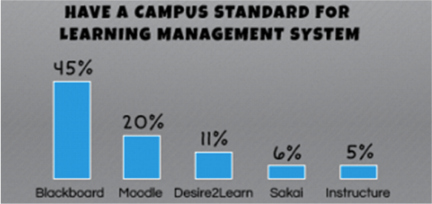
http://www.insidehighered.com/news/2012/11/07/tech-officials-weigh-big-data-moocs-and-open-source

Slide 18
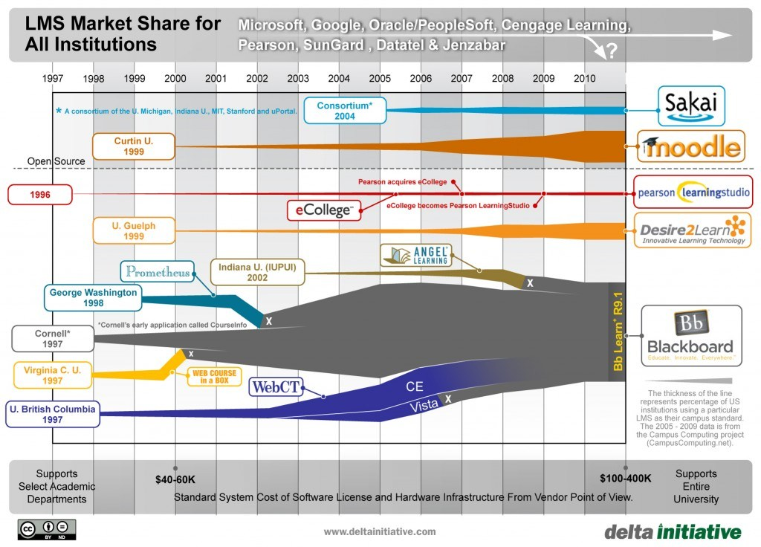
http://mfeldstein.com/state-of-the-higher-education-lms-market-a-graphical-view/

Slide 19
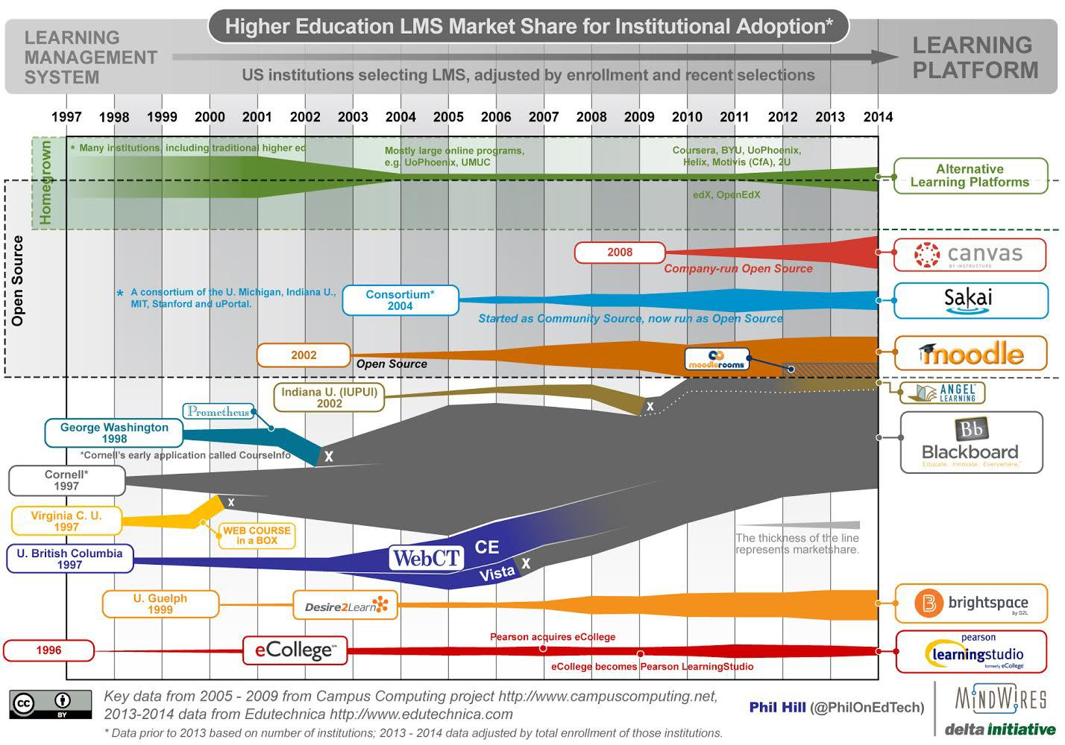
http://mfeldstein.com/state-us-higher-education-lms-market-2014-edition/

Slide 20
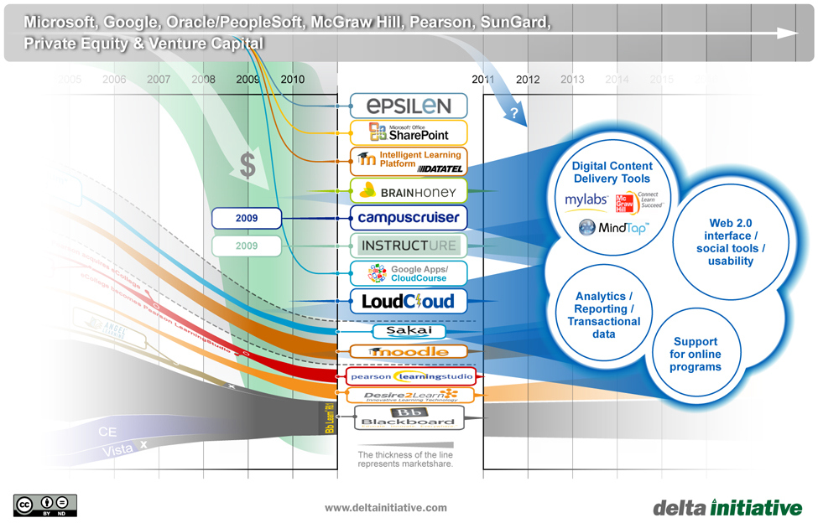
http://mfeldstein.com/emerging-trends-in-lms-ed-tech-market/

Slide 21
One of these things is not like the others:
www.masteringphysics.com
www.masteringastronomy.com
www.masteringpython.com

Slide 22
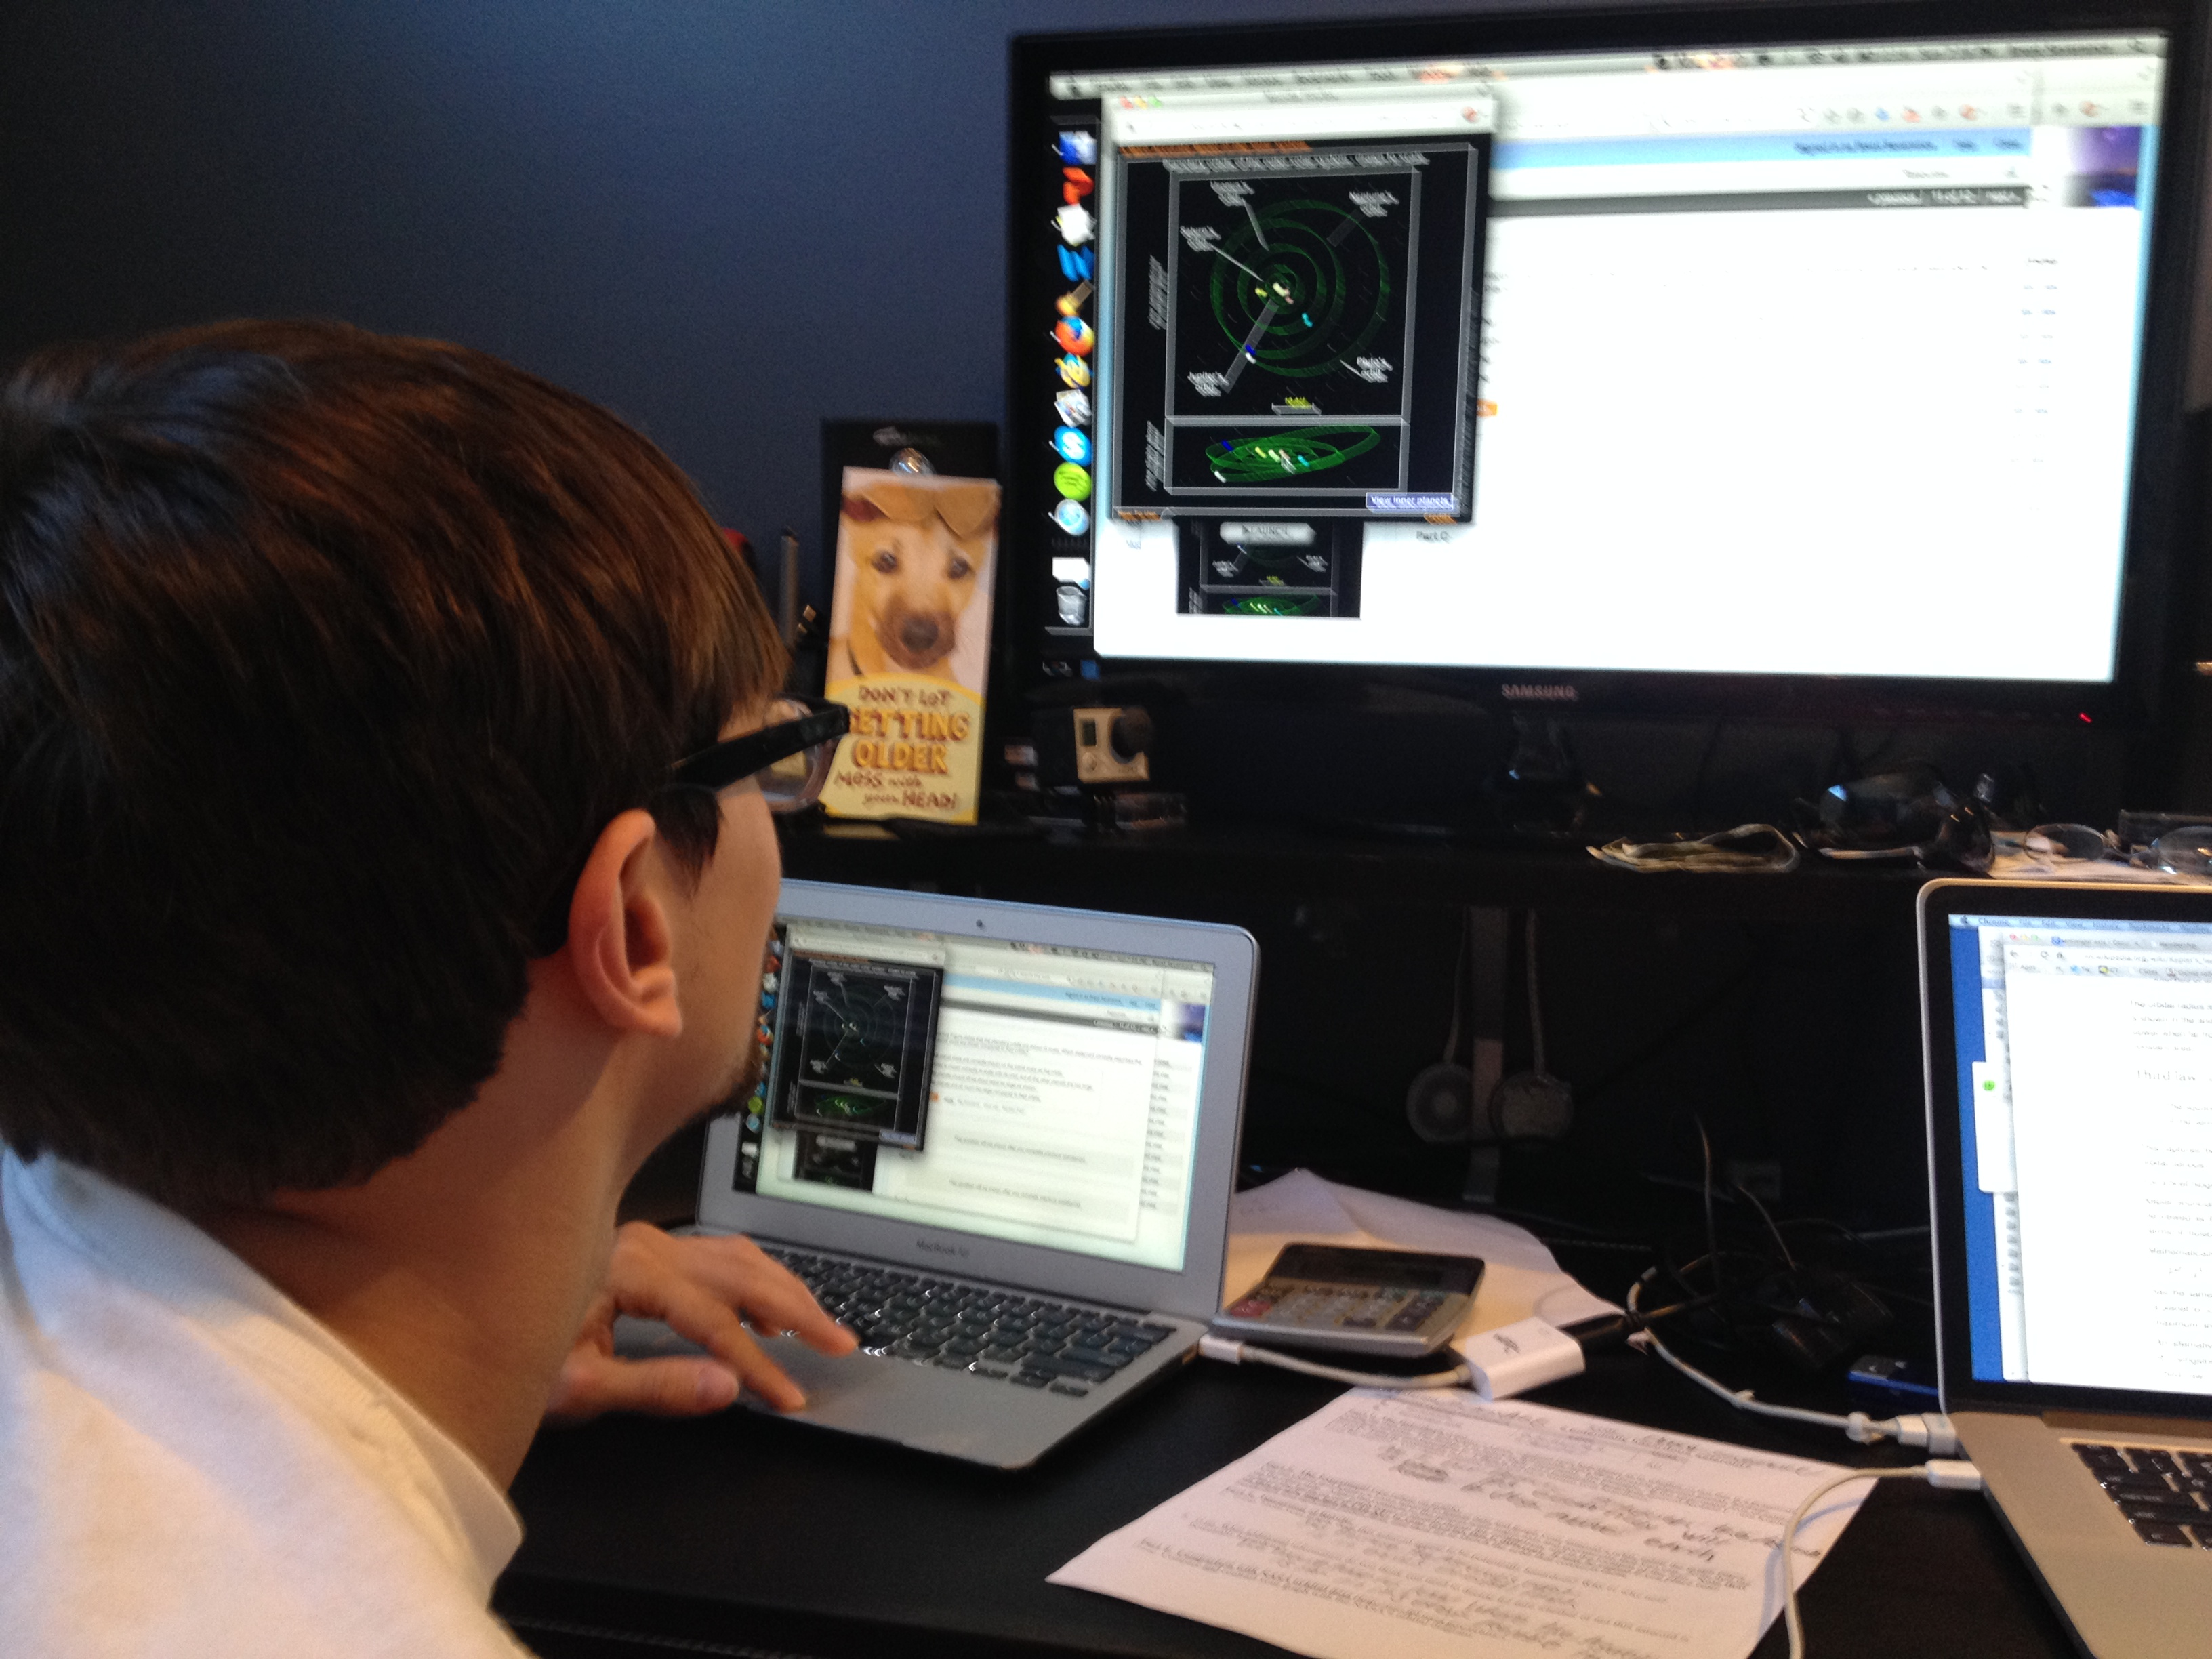

Slide 23
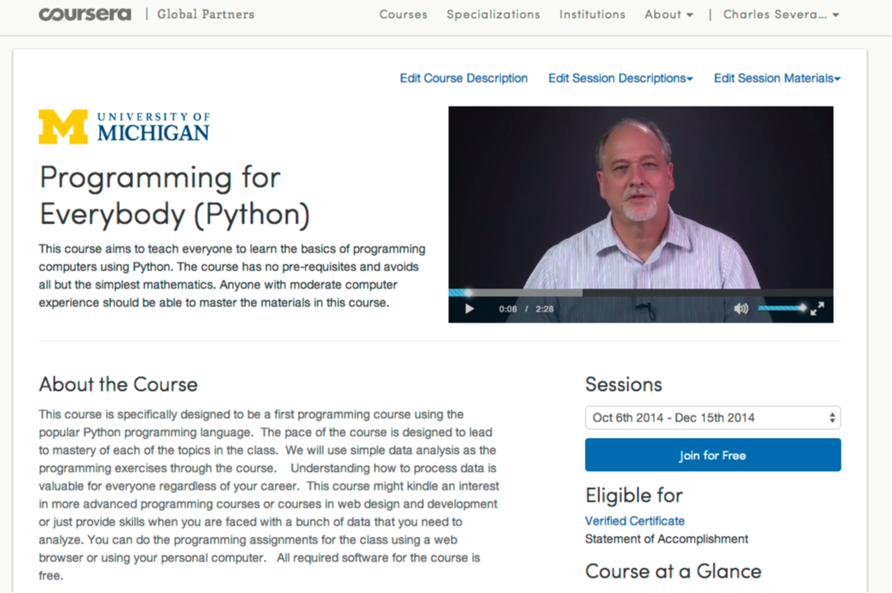

Slide 24
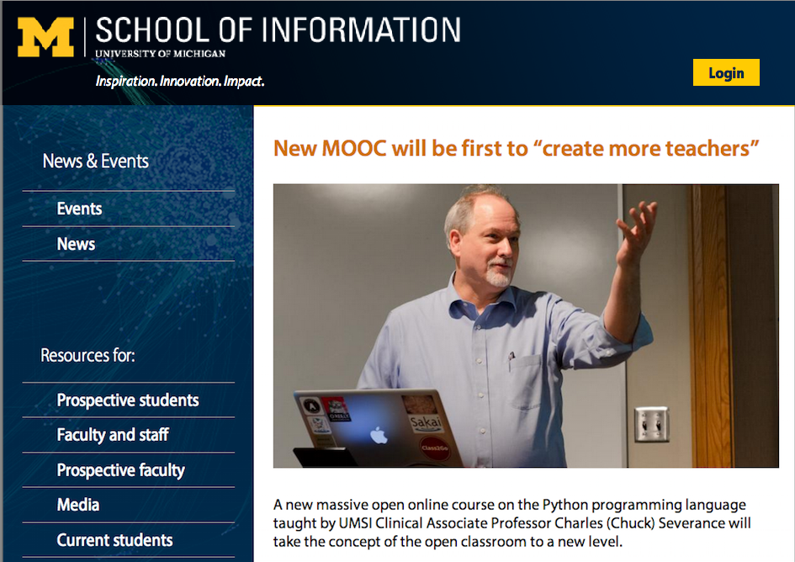

Slide 25
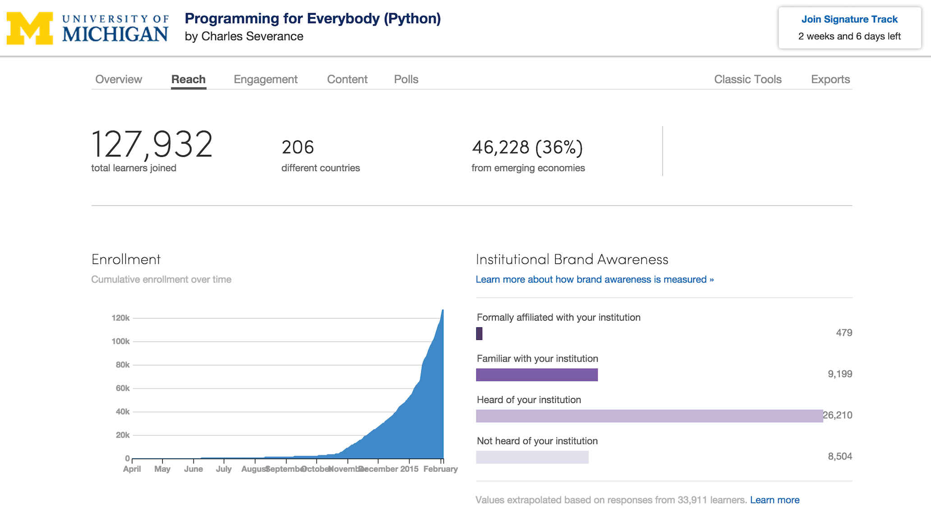

Slide 26
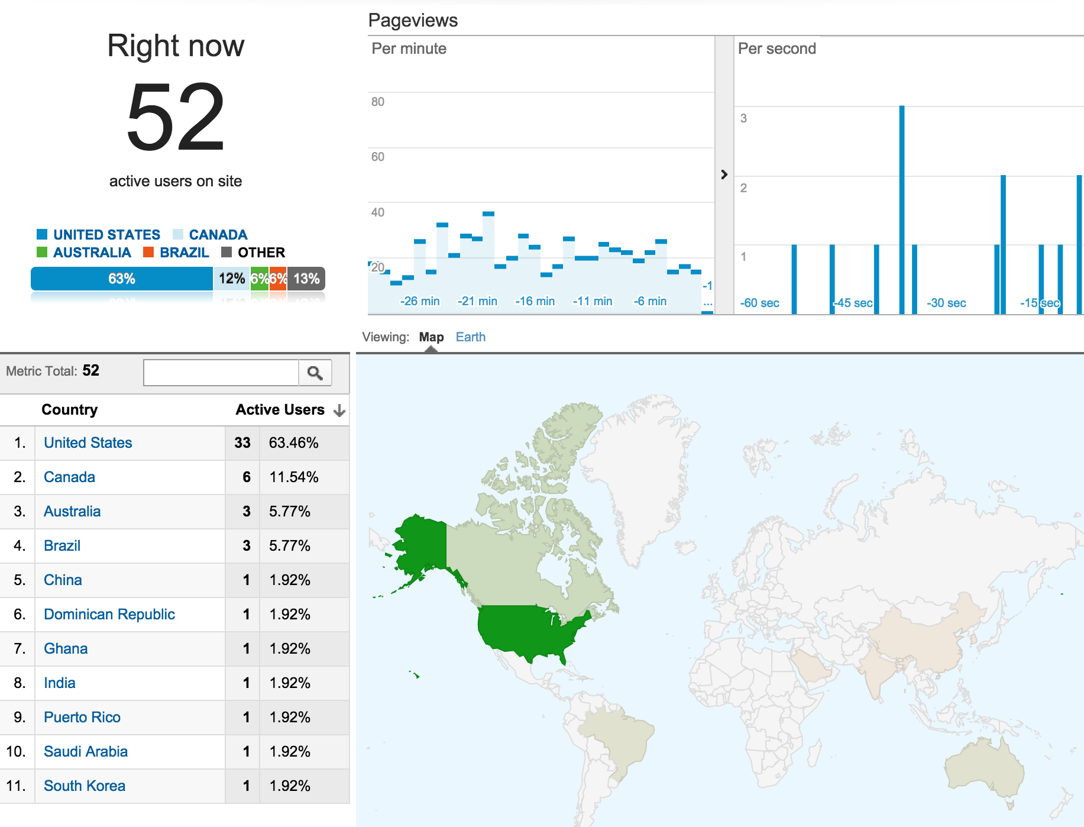

Slide 27
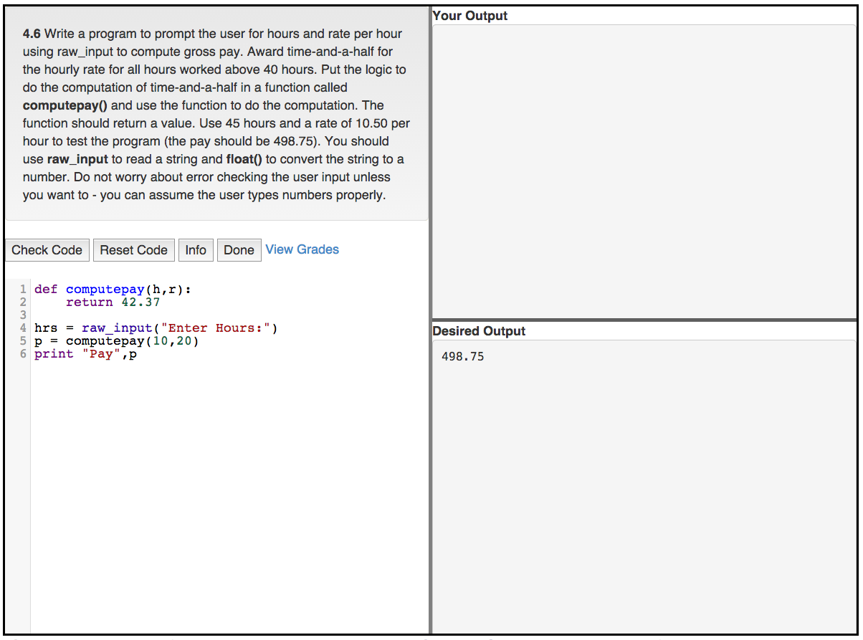
www.tsugi.org

Slide 28
Emerging Learning Systems
XERTE – 10:30
Karuta – 11:15
OpenCast – 13:45
Tsugi – www.tsugi.org
GradeCraft – www.gradecraft.com
ECoach - http://sitemaker.umich.edu/ecoach/home

Slide 29

D'Arcy Norman's Law of eLearning Tool Convergence
Any eLearning tool, no matter how openly designed, will eventually become indistinguishable from a Learning Management System once a threshold of supported use-cases has been reached.
http://darcynorman.net/2013/02/15/normans-law-of-elearning-tool-convergence/

Slide 30



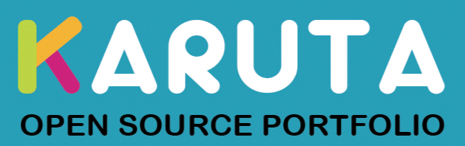
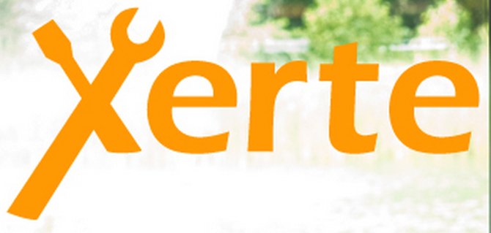
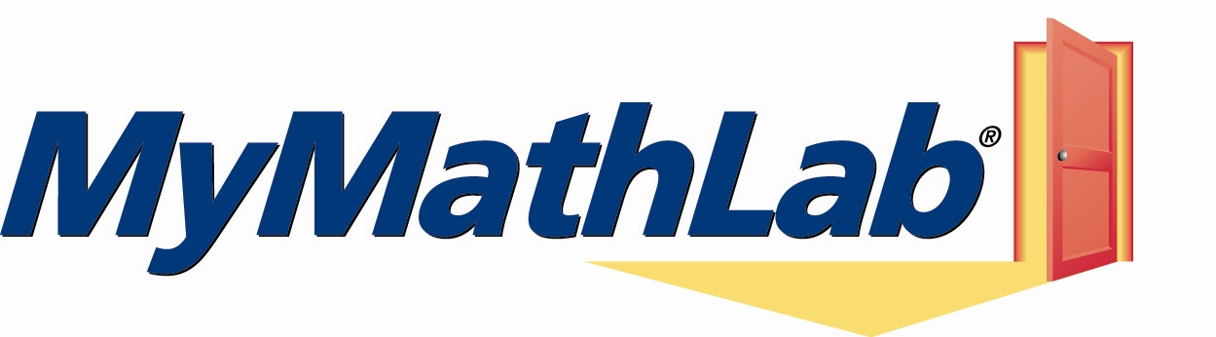


Slide 31
Learning
Systems
LMS
Learning Platform

Slide 32

Learning
Systems
???
Learning Platform

Slide 33
Learning
Systems
???
Learning Platform

Slide 34


Open Source
The Learning Platform must be a cooperative ecosystem
Learning Systems must avoid becoming just another LMS
Learning Systems will slowly change LMS systems
Open source is key

